Slide 1

Object-oriented Programming with Ruby
Robert Batzinger
CSCI A-201
Spring 2009

Slide 2
Arrays and Hashes: Collections of objects
Goals for this Section

Slide 3
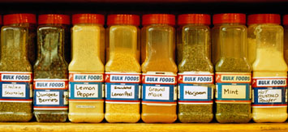
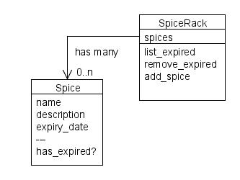
Storing collections
Occasionally we need an attribute for collecting and organizing a series of objects
Ruby has 3 built-in classes for doing this:
Arrays
Hashes
Strings

Slide 4
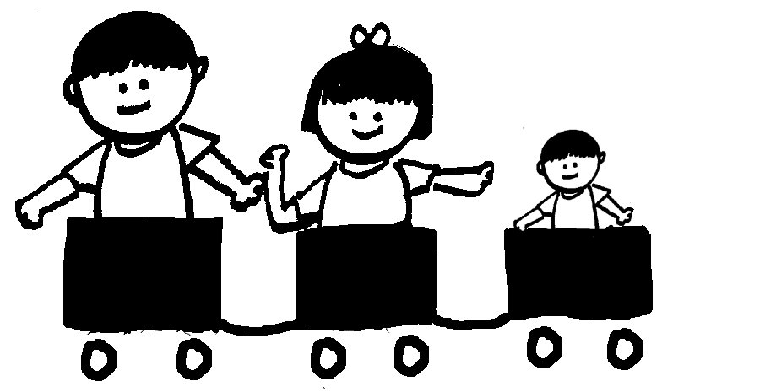
Arrays- a sequence of objects
Children:
Bill – 12 yrs
Mary – 9 yrs
George – 6 yrs
A sequence of containers that can hold objects of any class
Each object in sequence:
Has its own attributes and methods
Is independent from the other objects in the sequence
Position is the key

Slide 5
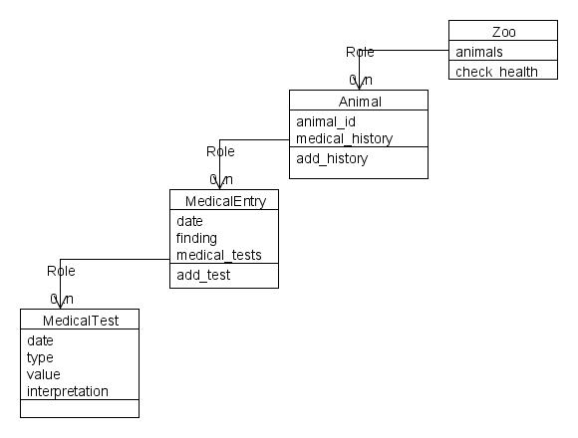
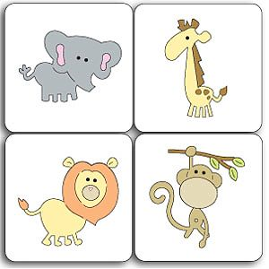
Array – another example
Zoo inventory:
Lion
Elephant
Giraffe
Monkey

Slide 6
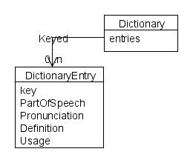
Hash – a lookup table
carapace
Part of Speech: noun
Pronunciation: [kara-peys]
Definition:
A hard outer covering or exoskeleton, such as the shell of a turtle or lobster;
any protective covering like a turtle shell, literal or figurative.
Usage: When life becomes too complicated for Ethylene, she pulls her head into her carapace and shuts out the world.
glasnost
Part of Speech: noun
Pronunciation: (gläs′nôst, -nōst)
Definition:
Opportunity to be heard
Usage: Their problems forced them to extend glasnost to their former enemies.
Associates an object with a lookup key
Useful for
Dictionaries
Data map
Can working with collections of objects from different classes

Slide 7
Strings
A sequence of characters
Useful for storing and manipulating text
Examples:
name = ’Robert Batzinger’
poems = ’The quick brown fox jumped over the dog’
department = ’Informatics’

Slide 8
Array methods
Addressing: Retrieves/sets the value
[ ], [ ]=
Adding to the ends of an array:
push, unshift
Remove elements from the array:
pop, shift, delete_at, delete, slice, slice!to
Reordering the elements in the array:
sort, sort!, reverse, reverse!
Measurement:
size, length

Slide 9
Hash methods
Look up an entry:
[ ]
Removing an entry:
delete
Checking existences:
has_key?, keys, values

Slide 10
String methods
Case:
swapcase, upcase, upcase!, downcase, downcase!, capitalize, capitalize!
Changing the text:
chomp, chomp!, reverse, reverse!, sub, gsub, split
Sizing
length, size

Slide 11
おわり The end

